Slide 1

TEMPLATE Assignment A5 Low-Fidelity Paper Prototype Examples: Project BearIt, CSC318 2019F Table of Contents
SAMPLE ONLY
5.1 Key Tasks 2 5.2 Usability Testing Script 3 5.3 Low-Fidelity Paper Prototype 4 with Facilitation & Observation notes off-side, outside Slideshow

Slide 2
A5.1 Key Tasks
Create a recurring event
View saved activities
Change event
Delete event
SAMPLE ONLY

Slide 3
A5.2 Usability Testing Script
SAMPLE ONLY
Scenario: You are a 3rd year computer science student. You heard from your friends that there is an app which can help you be more motivated and engaged in your long term goals. You decide to try this app. Can you show me how you would do the following tasks using this app:
1. You want to start working out regularly at the Athletic Centre on Wednesdays, from 8-9pm, starting on October 16. How can you set that up using this prototype?
2. How can you review the activity that you just added?
3. You just remembered that you have a midterm coming up so on October 16th you will need to prepare for the midterm instead of working out. How can you update that in your app?
4. You are happy, because your midterm was canceled! How can you remove the preparation activity from your app.
Please think aloud as you interact with the paper prototype.
Note how the Scenario sets up the participant into their role using a high level description and a realistic situation.
Note the open ended instruction without too much specific guidance.
1. Note how carefully the words are chosen to not bias the participant regarding the interface elements.
2. Note reference to recent activity without using specific UI vocab. Similarly all tasks avoid using any words that appear in the design.
Note the length of the entire test is about 7 minutes. So 4 simple tasks will suffice.
Note participant may not know to think aloud, nor do this naturally. You may need to remind and probe as they use your paper prototype.

Slide 4
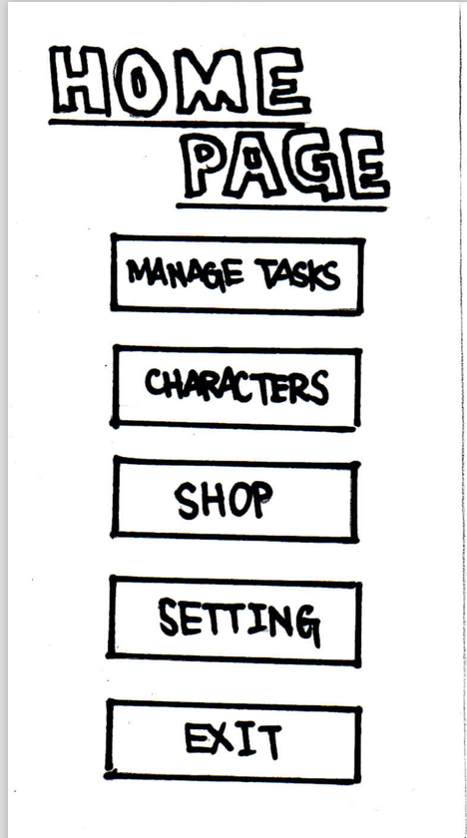
A5.3 Low-Fidelity Paper Prototype
Task 1. You want to start exercising regularly at the Athletic Centre on Wednesdays, from 8-9pm, starting on October 16. How can would you set that up using this prototype?
Note this column of text does not show during the Usability Test Slide Show; but is used for your note taking & record keeping.
Note the task instructions are repeated here to reduce participant’s memory load.
EXPECTED USER ACTION
Click [MANAGE TASKS]
OBSERVED ACTION
USER QUOTES
DESIGN IMPLICATIONS for A5b Results
SAMPLE ONLY

Slide 5
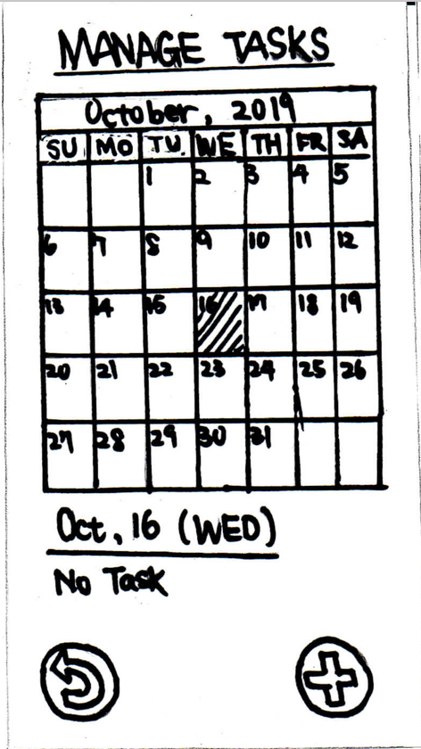
Note this column of text does not show during the Usability Test Slide Show; but is used for your note taking & record keeping.
EXPECTED USER ACTION
Click [October 16]
Click [ADD +]
OBSERVED ACTION
USER QUOTES
DESIGN IMPLICATIONS for A5b Results
Task 1. You want to start exercising regularly at the Athletic Centre on Wednesdays, from 8-9pm, starting on October 16. How can would you set that up using this prototype?
SAMPLE ONLY

Slide 6
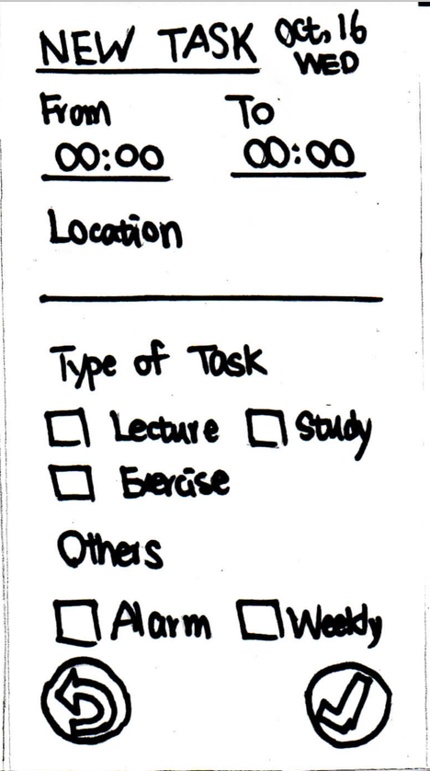
Note this column of text does not show during the Usability Test Slide Show; but is used for your note taking & record keeping.
EXPECTED USER ACTION
Type FROM [20:00]
Type TO [21:00]
Type LOCATION [Athletic Centre]
Check [EXERCISE]
Check [Weekly]
Check [Alarm (optional)]
Click [CHECK MARK] NOTE it’s good practice to ask users “What do you expect to happen next?”
OBSERVED ACTION
USER QUOTES
DESIGN IMPLICATIONS for A5b Results
[NEXT] button is an Action Button you can program in Powerpoint for navigation.
Task 1. You want to start exercising regularly at the Athletic Centre on Wednesdays, from 8-9pm, starting on October 16. How can would you set that up using this prototype?
SAMPLE ONLY
NEXT

